Slide 1
Diabetes Prediction Using Machine Learning

Slide 2
Introduction
This project aims to predict diabetes using machine learning techniques and a graphical user interface (GUI). It demonstrates key skills in machine learning (ML) and data visualization, allowing users to understand how glucose and insulin levels correlate with diabetes diagnosis.

Slide 3
01
Dataset

Slide 4
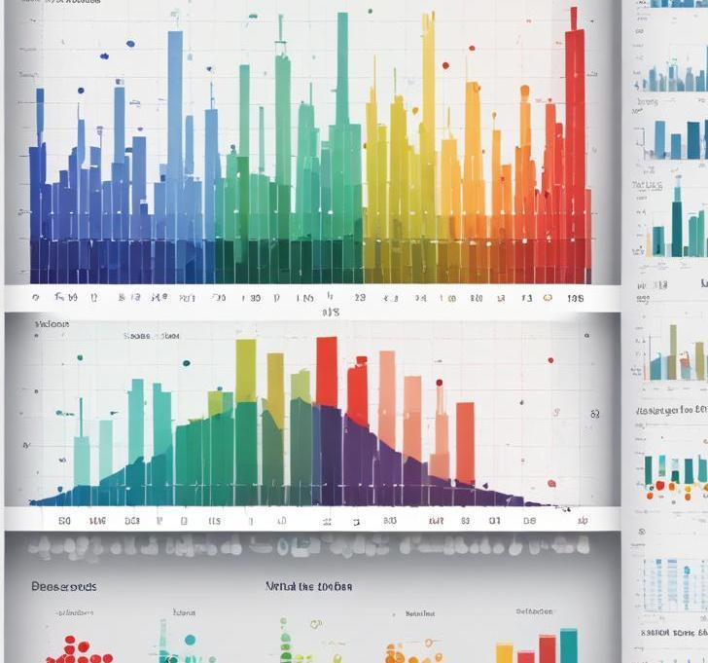
Sample size and features
The dataset consists of 15 samples, specifically chosen for this project to provide a manageable yet informative base for testing. Each sample contains two crucial features: glucose levels and insulin levels. These features are essential for assessing the likelihood of diabetes.

Slide 5
Binary target variable
The target variable in this dataset is binary, indicating whether an individual is diabetic (1) or non-diabetic (0). This simplification allows for effective classification using the chosen machine learning models.

Slide 6
Hardcoded for simplicity
For this project, the dataset is hardcoded within the program to simplify the process of demonstrating the machine learning predictions. This allows for straightforward testing and user interaction without the need for complex data loading mechanisms.

Slide 7
02
Models

Slide 8
K-Nearest Neighbors (KNN)
This model utilizes the K-Nearest Neighbors algorithm with k set to 3. It classifies instances based on the majority label of the three closest samples in the feature space. KNN is straightforward and effective, especially for small datasets, making it suitable for this project.

Slide 9
Logistic Regression
Logistic Regression is employed for binary classification of whether a user is diabetic or not. It calculates probabilities by fitting a logistic function to the data, allowing for interpretability of results. The model outputs the likelihood of diabetes based on user input.

Slide 10
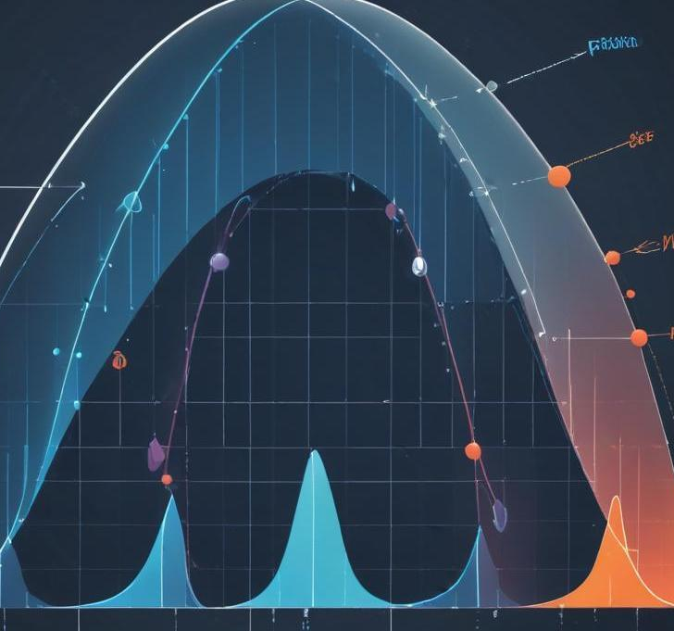
Gaussian Naive Bayes
Gaussian Naive Bayes assumes that features follow a Gaussian distribution and are independent. This model is particularly useful in binary classification scenarios. It calculates the posterior probability for each class and provides predictions based on the probability calculated from the input features.

Slide 11
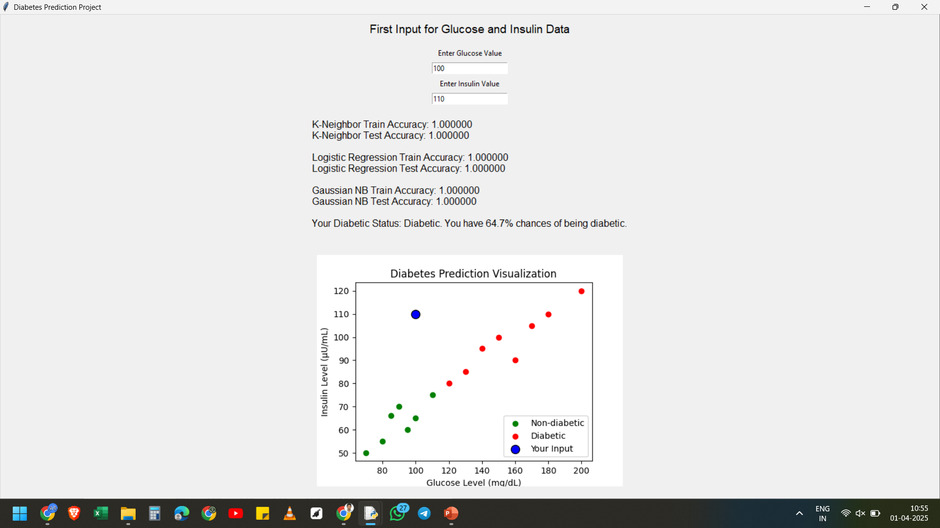
OUTPUT:-

Slide 12
USAGE OF LIBRARIES IN THE PROJECT:-
1. Tkinter (tk and ttk) – GUI Development
tkinter is Python’s built-in library for creating graphical user interfaces (GUIs).
ttk (Themed Tkinter Widgets) provides improved styling and modern-looking widgets.
2. NumPy (numpy as np) – Numerical Computation
NumPy provides support for working with arrays, matrices, and numerical calculations.
3. scikit-learn (sklearn) – Machine Learning
train_test_split: Splits the dataset into training and testing sets.
KNeighborsClassifier: Implements K-Nearest Neighbors (KNN) classification.
4. Matplotlib (matplotlib.pyplot as plt) – Data Visualization
pyplot provides tools for plotting graphs.
FigureCanvasTkAgg integrates Matplotlib plots into Tkinter GUIs.

Slide 13
Conclusions
This project effectively demonstrates the integration of machine learning with a user-friendly GUI to predict diabetes. By utilizing KNN, Logistic Regression, and Gaussian Naive Bayes, the program educates users on prediction methodologies while enabling interactivity through a visual interface. Future improvements may include using a larger dataset and incorporating more advanced models.

Slide 14

tHANK yOU

